Slide 1
Introduction to
Artificial Intelligence and Machine learning
Dr Basel Barakat
basel.barakat@sunderland.ac.uk

Slide 2
Introduction
Who:
Dr Basel Barakat, DG217
basel.barakat@sunderland.ac.uk
9.30 – 12pm | AI/ML – Session 1
12pm – 12.30 pm | Lunch
12.30 – 4 pm | Ai/ML- Session 2
4pm – 4.15pm | Close

Slide 3
My current projects
Using Timeseries Forecasting For Achieving Net-zero
Explaining The Hate Speech Detectors Performance
Time Sensitive IoT Applications Communication Polices
Fine Tuning Deep Neural Networks For Task Specific Classifiers
Medical Research Developing Tools For Impowering Medical Researchers
Healthcare Using Machine Learning For Contactless Detecting Of Falls

Slide 4
Introduction
What we will cover:
# | Topic
1 | Introduction to AI and ML
2 | Search Algorithms
3 | Machine Learning Regression
4 | Machine Learning Classification
5 | Machine Learning Clustering
6 | Computer Vision
7 | AI Ethics

Slide 5
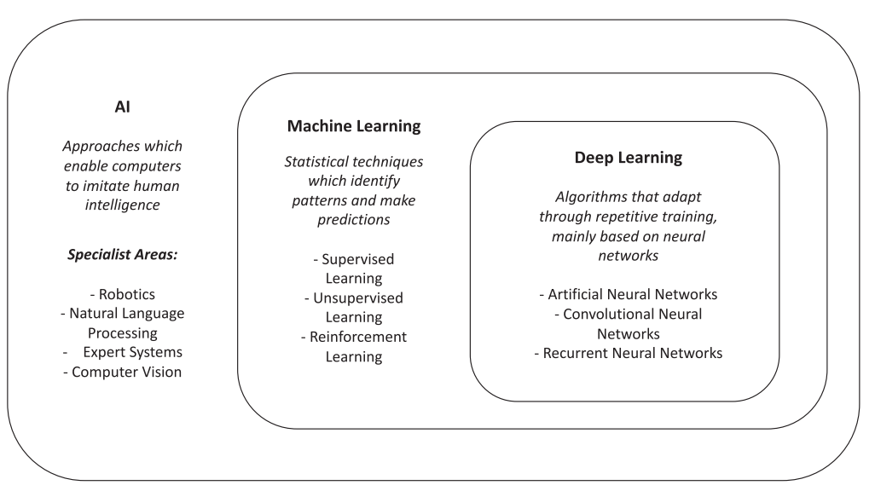
AI, ML and Deep Learning
Allen, B., McGough, A.S. and Devlin, M., 2021. Toward a framework for teaching artificial intelligence to a higher education audience. ACM Transactions on Computing Education (TOCE), 22(2), pp.1-29.

Slide 6
Introduction to
Search Algorithms
Dr Basel Barakat
basel.barakat@sunderland.ac.uk

Slide 7
Search in AI
Searching on organising data is an important topic in AI
There are many problems that need to computer to search for the optimum or correct solution for a given domain
There are often many solutions to a given problem and we may not know which is the best until we have tried them out
If we are effective in organising our data, we can search for solutions quickly and efficiently

Slide 8
Types of search Techniques
Search Algorithms
Uninformed
Depth First Search (DFS)
Breadth First Search (BFS)
Uniform Cost Search (UCS)
Informed
Greedy
A*
Graph

Slide 9
Uninformed Search Techniques
Breadth First Search (BFS) - is a traversing algorithm where you should start traversing from a selected node (source or starting node) and traverse the graph layer wise thus exploring the neighbor nodes (nodes which are directly connected to source node)
Depth First Search (DFS) - is an algorithm for traversing or searching tree or graph data structures.
The algorithm starts at the root node (selecting some arbitrary node as the root node in the case of a graph) and explores as far as possible along each branch before backtracking.
Uniform Cost Search (UCS) - is the best algorithm for a search problem, which does not involve the use of heuristics. It can solve any general graph for optimal cost. Uniform Cost Search as it sounds searches in branches which are more or less the same in cost, this demands the use of a priority queue.

Slide 10
Search strategies
A strategy is defined by picking the order of node expansion
Strategies are evaluated along the following dimensions:
Completeness does it always find a solution if one exists?
Time Complexity number of nodes generated/expanded
Space Complexity maximum number of nodes in memory
Optimality does it always find a least-cost solution?

Slide 11
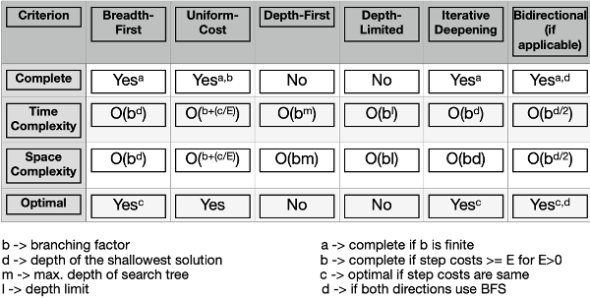
Summary of Uninformed SA

Slide 12
Informed search algorithms
The informed search algorithm is also called heuristic search or directed search.
Informed search algorithms require details such as distance to reach the goal, steps to reach the goal, cost of the paths which makes this algorithm more efficient.
The heuristic function is used to achieve the goal state with the lowest cost possible. This function estimates how close a state is to the goal.

Slide 13

Greedy Search
Greedy best-first search uses the properties of both depth-first search and breadth-first search.
Greedy best-first search traverses the node by selecting the path which appears best at the moment.
The closest path is selected by using the heuristic function.

Slide 14
A* search
A* search algorithm is a combination of both uniform cost search and greedy best-first search algorithms.
It uses the advantages of both with better memory usage.
It uses a heuristic function to find the shortest path.
A* search algorithm uses the sum of both the cost and heuristic of the node to find the best path.

Slide 15
A* Search
It is best-known form of Best First search.
It avoids expanding paths that are already expensive but expands most promising paths first.
f(n) = g(n) + h(n),
Where:
g(n) the cost (so far) to reach the node
h(n) estimated cost to get from the node to the goal
f(n) estimated total cost of path through n to goal. It is implemented using priority queue by increasing f(n).

Slide 16
Genetic Algorithms
Type of search for a solution
Consists of simple set of instructions repeated
Concept based on ideas from biological evolution
Organise on basis of environment - like organisms
Good where search space is unknown/discontinuous
Part of artificial life (a-life) & stochastic (random) systems - branches of AI

Slide 17
Introduction to
Machine Learning
Dr Basel Barakat
basel.barakat@sunderland.ac.uk

Slide 18
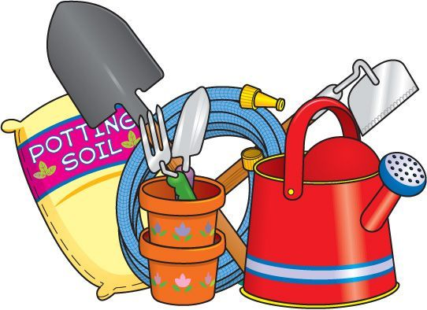
Sounds like magic?
No, its more like gardening:
Seeds = Algorithms
Nutrients = Data
Gardener = You
Plants = Programs

Slide 19

ML overview

Slide 20
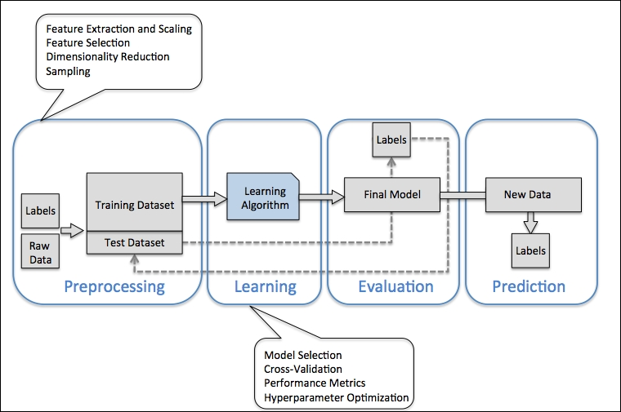
Building Machine Learning Systems

Slide 21
Data Pre-processing
Data Cleaning
The goal of Data Cleaning is to ensure that the data is accurate, consistent, and free of errors, as incorrect or inconsistent data can negatively impact the performance of the Machine Learning
Pre-Processing
Data Transformation
It involves converting data from its raw state into a format that can be understood and used by machine learning algorithms
Data Reduction
Aims to reduce the size of a dataset while still preserving the most important information

Slide 22
Data Cleaning
Data Cleaning
Removing duplicate data points
Handling noisy data and outliers
Standardizing data formats
Handling Missing Data

Slide 23
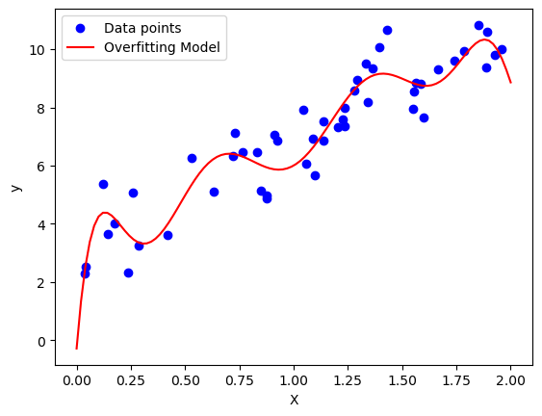
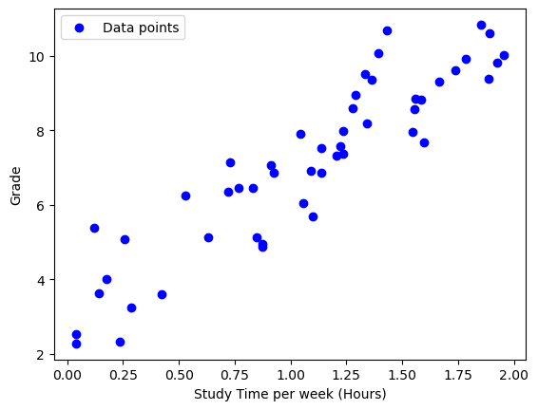
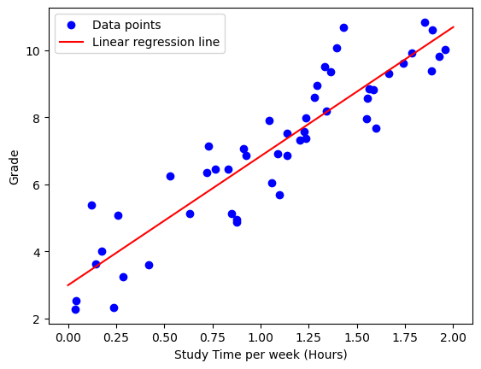
Regression Example

Slide 24
Multiple linear regression
student's school
student's sex
student's age
student's home address type
family size
parent's cohabitation status
mother's education
father's education
mother's job
father's job
attended nursery school
wants to take higher education
Internet access at home
with a romantic relationship
quality of family relationships
free time after school
going out with friends
workday alcohol consumption
weekend alcohol consumption
current health status
number of school absences
reason to choose this school
student's guardian
home to school travel time
weekly study time
number of past class failures
extra educational support
family educational support
extra paid classes within the course subject
Cortez,Paulo. (2014). Student Performance. UCI Machine Learning Repository. https://doi.org/10.24432/C5TG7T.

Slide 25
Machine Learning Classification
Dr Basel Barakat
basel.barakat@sunderland.ac.uk

Slide 26


Classification
Classification is a task that requires the use of machine learning algorithms that learn how to assign a class label to examples from the problem domain.
Examples:
Classifying emails as “spam” or “not spam”
Classifying Images to ‘Dog’ or ‘Cat’
Classifying Product review to ‘+ve’ or ‘-ve’
‘This product is awesome, it stopped working after the second use’

Slide 27
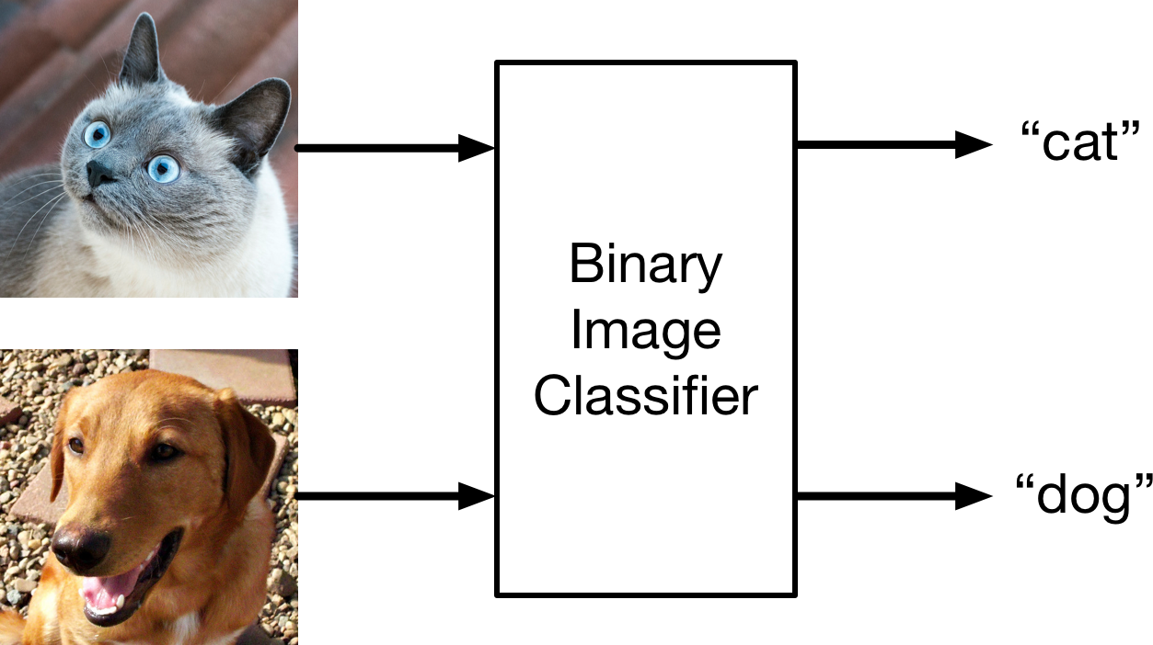
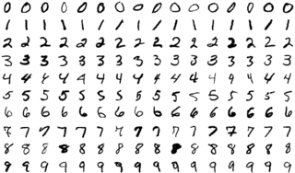
Types of Classification
Binary Classification
Multi-Class Classification
Multi-Label Classification

Slide 28
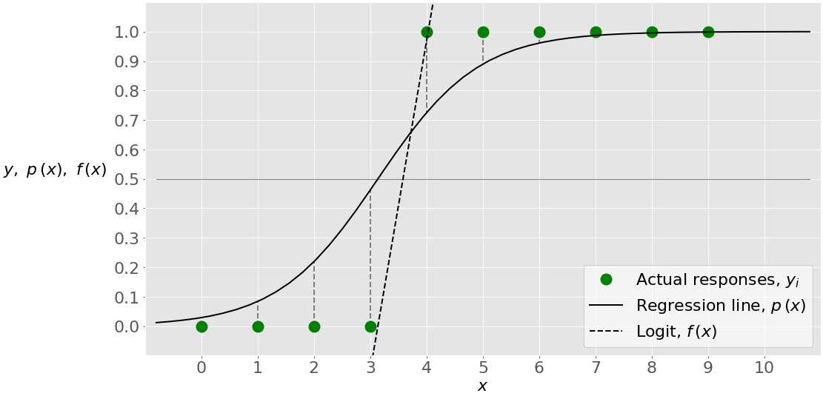
Logistic Regression
Logistic Regression: is a statistical method used for predicting the probability of a binary outcome based on one or more predictor variables.
https://www.geeksforgeeks.org/understanding-logistic-regression/

Slide 29
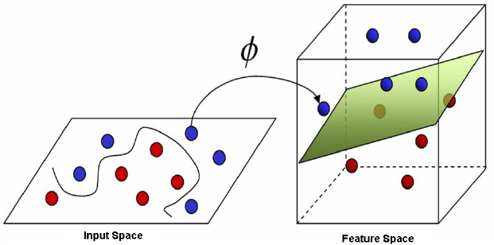
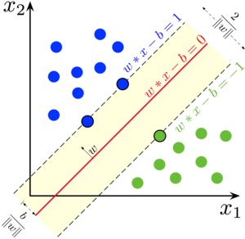
Support Vector Machines
Support Vector Machines (SVM): is a powerful supervised learning algorithm that can be used for both classification and regression tasks.
It works by finding the optimal hyperplane that separates data points of different classes while maximizing the margin between the classes.
SVMs are effective in handling complex, high-dimensional data and are widely used in text categorization, image recognition, and bioinformatics.

Slide 30
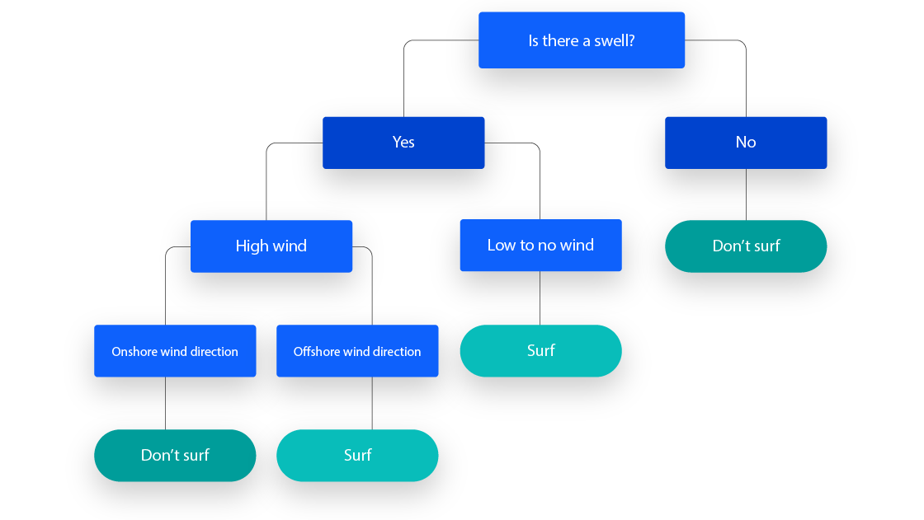
Decision Trees
Decision Trees: are versatile supervised learning models that are used for both classification and regression tasks.
They work by recursively partitioning the data based on the features to create a tree-like model that can be used for decision-making.
Decision Trees are easy to interpret and visualize, making them popular in fields such as finance, healthcare, and marketing for making transparent and understandable decisions.

Slide 31
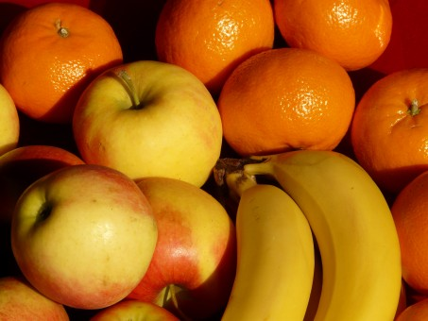
Example Decision Trees
Classes: (Banana, Red Apple, Tangerine )
Features:
Colour (Green, Red, Yellow, Orange)
Texture (Smooth, Rough)
Is the fruit colour yellow?
Yes: Classify as a Banana
No: Continue to the next condition.
Is the fruit texture smooth or rough?
Smooth: Classify as an Apple.
Rough: Classify as a Tangerine.

Slide 32
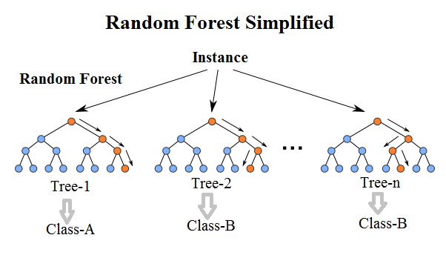
Random Forest
Random Forest: is an ensemble learning technique that combines multiple decision trees to improve the overall performance and robustness of the model. It works by creating a multitude of decision trees and then averaging their predictions to make the final decision.
Random Forests are effective in handling large, complex datasets and are widely used in various applications such as remote sensing, bioinformatics, and finance.

Slide 33
So, we did a classification how to know if the classifier is good?

Slide 34
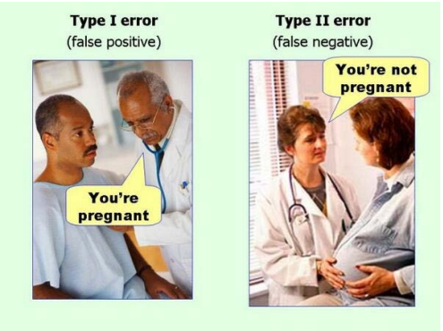
Type I and II Errors
True positive is an outcome where the model correctly predicts the positive class.
True negative is an outcome where the model correctly predicts the negative class.
False positive is an outcome where the model incorrectly predicts the positive class.
False negative is an outcome where the model incorrectly predicts the negative class.

Slide 35
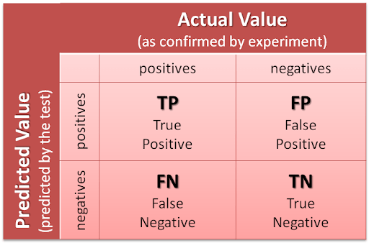
Classification Evaluation matrices
Confusion Matrix: is a table that presents the model's predictions compared to the actual labels. It provides a comprehensive view of the model's performance, showing true positives, true negatives, false positives, and false negatives.

Slide 36
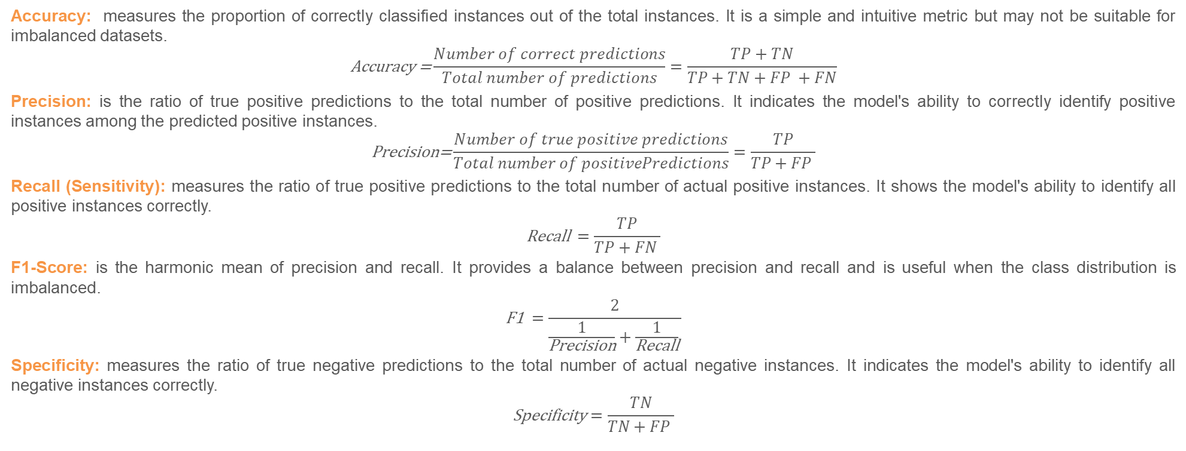
Evaluation Metrics
Accuracy: measures the proportion of correctly classified instances out of the total instances. It is a simple and intuitive metric but may not be suitable for imbalanced datasets.
$$\text{Accuracy}\text{ =}\frac{Number of correct predictions}{Total number of predictions}=\frac{TP+TN}{TP+TN+FP +FN}$$
Precision: is the ratio of true positive predictions to the total number of positive predictions. It indicates the model's ability to correctly identify positive instances among the predicted positive instances.
$$\text{Precision}\text{=}\frac{Number of true positive predictions}{Total number of positivePredictions}=\frac{TP}{TP+FP }$$
Recall (Sensitivity): measures the ratio of true positive predictions to the total number of actual positive instances. It shows the model's ability to identify all positive instances correctly.
$$\text{Recall} =\frac{TP}{TP+FN }$$
F1-Score: is the harmonic mean of precision and recall. It provides a balance between precision and recall and is useful when the class distribution is imbalanced.
$$\text{F}\text{1 }=\frac{2}{\frac{1}{\text{Precision}}+\frac{1}{\text{Recall}} }$$
Specificity: measures the ratio of true negative predictions to the total number of actual negative instances. It indicates the model's ability to identify all negative instances correctly.
$$\text{Specificity}=\frac{TN}{TN+FP }$$

Slide 37
Evaluation Metrics
Area Under the Receiver Operating Characteristic Curve (AUC-ROC): is a performance metric that evaluates the model's ability to discriminate between classes. It represents the area under the ROC curve and provides a comprehensive measure of the model's performance across various classification thresholds.
Area Under the Precision-Recall Curve (AUC-PRC): is similar to AUC-ROC but focuses on the trade-off between precision and recall. It is particularly useful when dealing with imbalanced datasets and when the positive class is rare.
https://developers.google.com/machine-learning/crash-course/classification/roc-and-auc

Slide 38
Machine Learning Clustering
Dr Basel Barakat
basel.barakat@sunderland.ac.uk

Slide 39
Unsupervised learning
Dimensionality reduction
Clustering
Anomaly detection

Slide 40
Clustering Outline
Clustering
Unsupervised technique
Organises data into groups based on some sort of similarity measure
Groups data into clusters, elements in a given cluster are similar to each other but dissimilar to elements in other clusters
Clustering Techniques
Hierarchical Algorithms
Partitional Algorithms
Clustering Large Databases

Slide 41
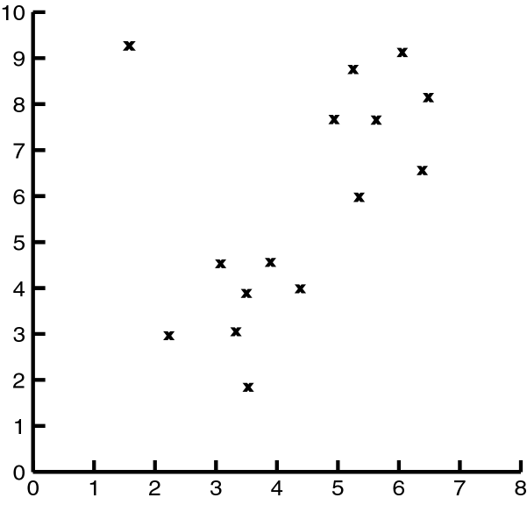
Impact of Outliers on Clustering

Slide 42
Impact of Outliers on Clustering
Outlier

Slide 43
Clustering Problem
Given a database D={t₁,t₂,…,t_{n}} of tuples and an integer value k, the
Clustering Problem is to define a mapping f:Dg{1,..,k} where each t_{i} is assigned to one cluster K_{j}, 1<=j<=k.
A Cluster, K_{j}, contains precisely those tuples* mapped to it.
Giving that clusters are not known a priori.
Outlier

Slide 44
Types of Clustering
Hierarchical – Nested set of clusters created.
Partitional – One set of clusters created.
Incremental – Each element handled one at a time.
Simultaneous – All elements handled together.
Notes:
1. Hierarchical:
- *Explanation:* In hierarchical clustering, the algorithm builds a tree-like structure of nested clusters. It starts by considering each data point as an individual cluster and then iteratively merges or splits clusters based on their similarity until a hierarchy of clusters is formed. This hierarchy is often represented as a dendrogram, showing the relationships between clusters at different levels.
2. Partitional:
- *Explanation:* Partitional clustering involves creating one set of non-overlapping clusters. The goal is to partition the dataset into distinct groups, and each data point belongs to exactly one cluster. Common partitional clustering algorithms include k-means and partitioning around medoids (PAM).
3. Incremental:
- *Explanation:* Incremental clustering involves processing each element or data point one at a time. As new data points arrive, the clustering algorithm is updated dynamically. This approach is useful in scenarios where data is continuously streaming or arriving in real-time, and the clustering model needs to adapt incrementally.
4. Simultaneous:
- *Explanation:* Simultaneous clustering, also known as batch clustering, involves handling all elements or data points together at once. The algorithm processes the entire dataset simultaneously to create clusters. This is in contrast to incremental clustering, where the data is processed sequentially as it arrives.$

Slide 45
K-means algorithm
The goal of the K-means algorithm is to partition a dataset into K distinct, non-overlapping subgroups (clusters) based on the characteristics of the data.
Each data point is assigned to the cluster whose mean (centroid) is closest to it. The algorithm iteratively refines these clusters until a convergence criterion is met.

Slide 46
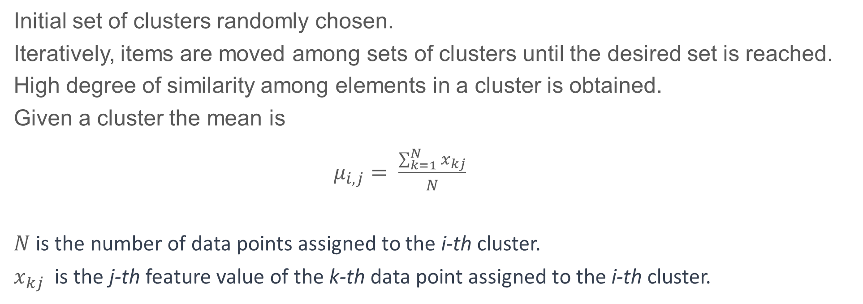
How does K-Means work?
Initial set of clusters randomly chosen.
Iteratively, items are moved among sets of clusters until the desired set is reached.
High degree of similarity among elements in a cluster is obtained.
Given a cluster the mean is
$μ_{i,j}= \frac{\sum_{k=1}^{N}{x_{kj}}}{N}$
$N$ is the number of data points assigned to the i-th cluster.
$x_{kj}$​ is the j-th feature value of the k-th data point assigned to the i-th cluster.

Slide 47
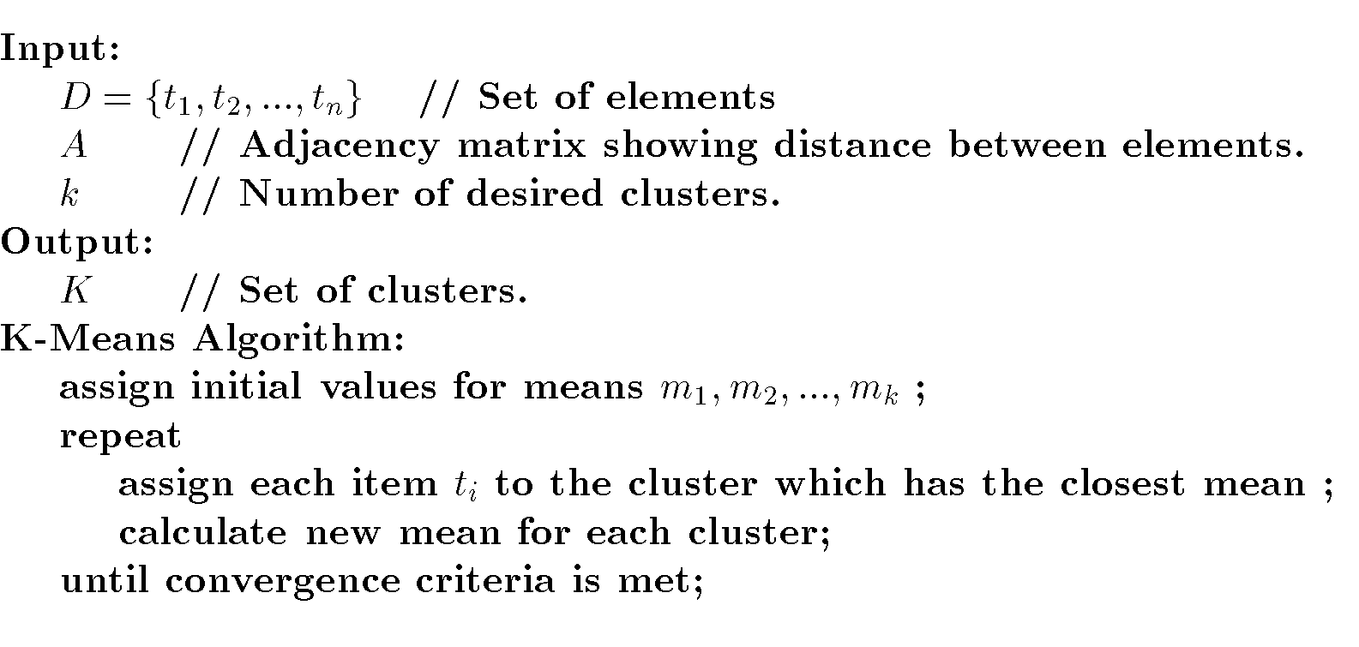
Put simply…

Slide 48
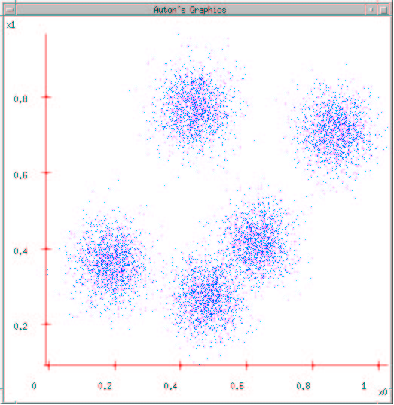
K-Means
Need to take data and show it on a graph
Measure things and show on x, y, z etc axes

Slide 49
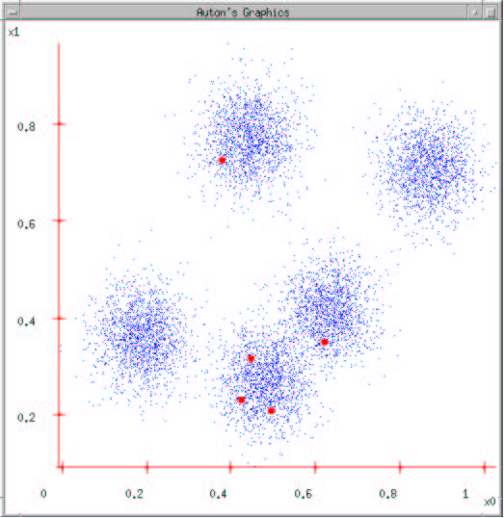
K-Means
Say how many categories you want! Let’s say 5.
Use hierarchical cluster tree views (pdist & linkage) to help determine number of clusters
Choose a point for the centre (centroid) of each category.

Slide 50
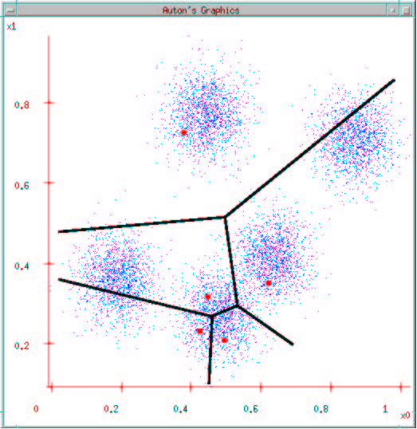
K-Means
Allocate each object (point) to its nearest centroid.
This divides up the space and classifies each object as belonging to a category.
Rather like ‘The French’ live in the area of space called France; the Spanish in the area of land called Spain.

Slide 51
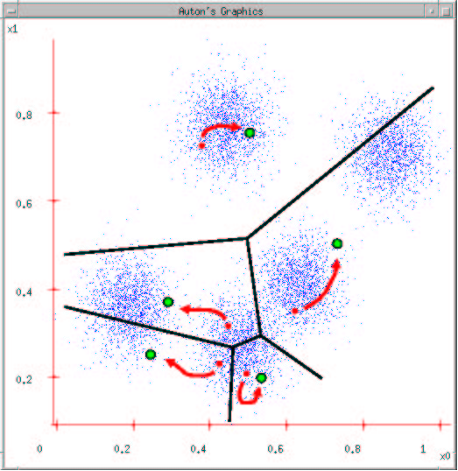
K-Means
But we’re not done yet……..
We need to see if we have found the real centre of these points.
So we recalculate the centre again – it may move….
Until it no longer moves – then we’ve classified all and know the category members.
Running the procedure groups the closest.
NB closeness defined in several ways: x1*x2 + y1*y2 etc
√((x₂ - x₀)² + (y₂ - y₀)²) - Euclidean ‘crow flies’ distance by cosine rule
Centre becomes mean average of the points in the cluster
City block – as above but centre becomes median (middle value) of points
if binary number the metric is the number of bits that differ - Hamming

Slide 52
K-Means clustering
Place K points into the space represented by the objects that are being clustered. These points represent initial group centroids (centres).
Assign each object to the group that has the closest centroid.
When all objects have been assigned, recalculate the positions of the K centroids. This may lead to the centroid being placed elsewhere.
Repeat above until the centroids no longer move. This produces a separation of the objects into groups from which the metric to be minimized can be calculated.

Slide 53
Example K-Means
Data values in 1D = 1, 2, 3, 8, 9, 10, 25
Divide on a hunch 1, 2, 3 8, 9,10,25
Cluster one = 1, 2, 3 has mean 2 (6/3)
Cluster two = 8, 9, 10, 25 has mean 13 (52/4)
Compare cluster 1 to mean2
(1 -2 )²+ (2-2 )²+ (3 -2 )²
and cluster 2 with outlier
+ (8 -13 )²+ (9 -13 )²+ (10 -13 )²+ (25 -13 )² =196
Other groupings may have lower costs

Slide 54
Example K-Means
Data values in 1D = 1, 2, 3, 8, 9, 10, 25
Divide on a hunch 1, 2, 3 8, 9,10, 25 outlier
Cluster one = 1, 2, 3 has mean 2 (6/3)
Cluster two = 8, 9, 10 has mean 9 (27/3)
Compare cluster 1 to mean2
(1 -2 )²+ (2-2 )²+ (3 -2 )²
and cluster 2 without outlier
+ (8 -9 )²+ (9 -9 )²+ (10 -9 )² = 4

Slide 55
K-Means
Advantages
Guaranteed to stop
Simple
Disadvantages
can return different answers if re-run
So run many times!
Place initial centre randomly
Place other centres as far away from previous ones as possible
Won't necessarily return optimal classification

Slide 56
Computer Vision
Dr Basel Barakat
basel.barakat@sunderland.ac.uk

Slide 57
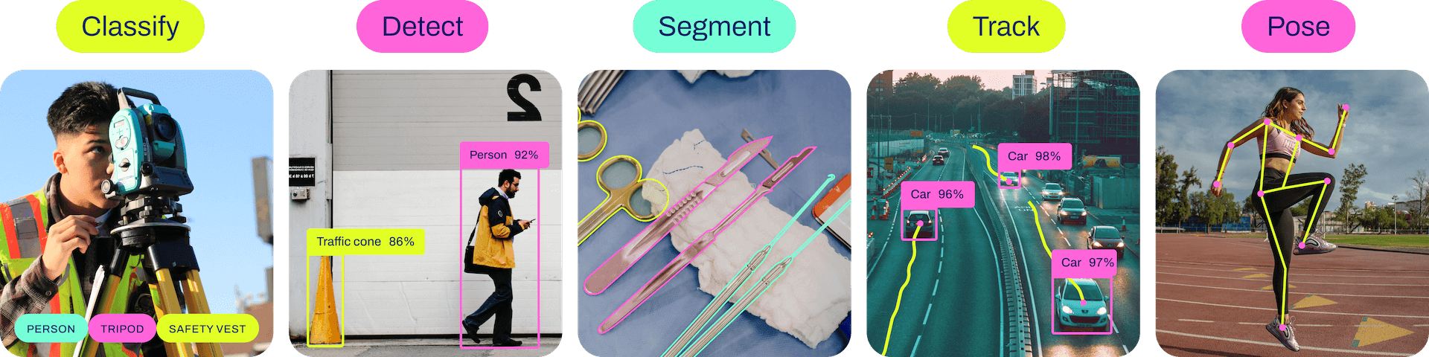
Computer Vision
Anomaly Detection
Image Classification
Image Segmentation
Object Detection
ultralytics/ultralytics: NEW - YOLOv8 🚀 in PyTorch > ONNX > OpenVINO > CoreML > TFLite (github.com)

Slide 58
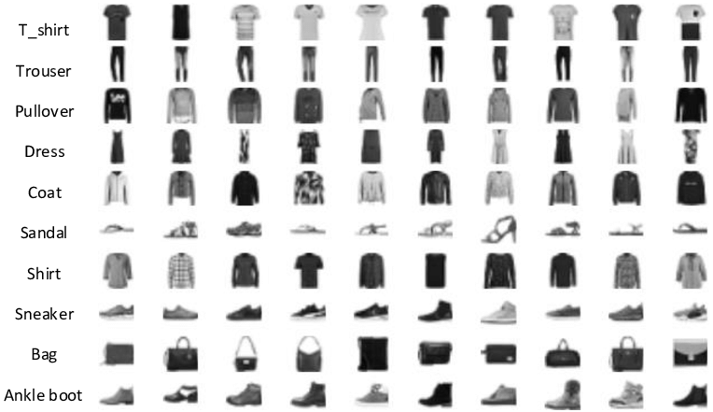
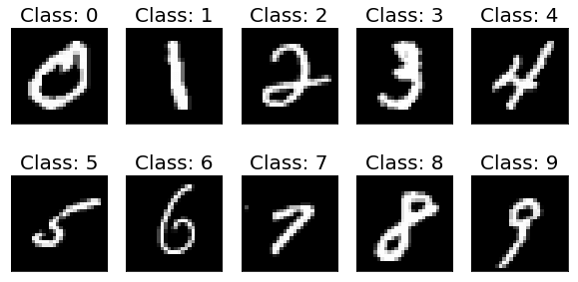
Image Classification

Slide 59
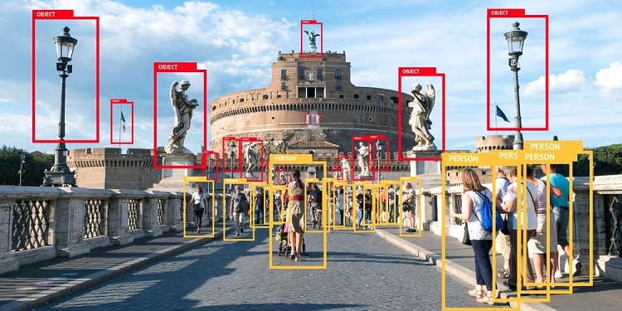
Object Detection
Person tracking algorithms can track people walking in front of cluttered backgrounds

Slide 60
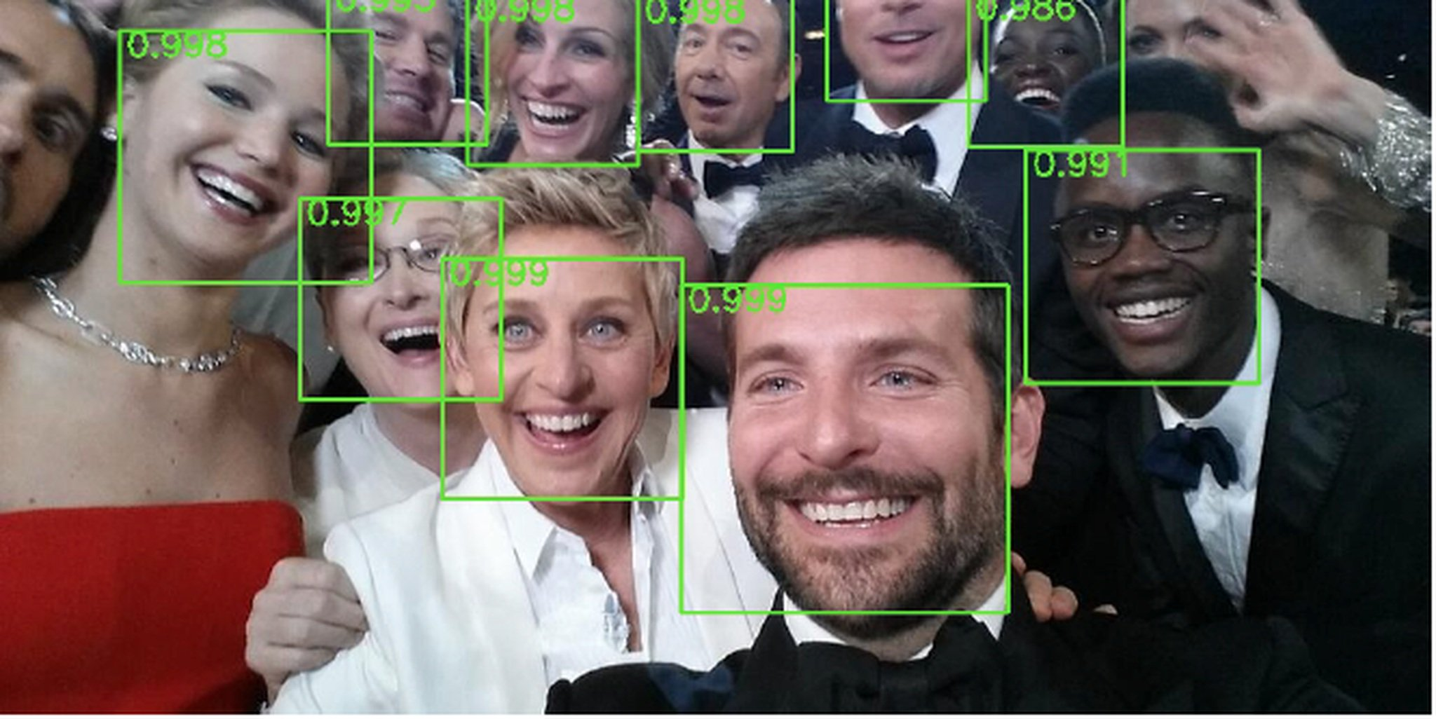
Computer Vision Algorithms and Applications
Face detection algorithms, coupled with colour based clothing and hair detection algorithms can locate and recognize individuals in a given image..

Slide 61
AI Ethics
Dr Basel Barakat
basel.barakat@sunderland.ac.uk

Slide 62
Potential issues
Technology is often full of blind spots, biases and ethical errors
These can exacerbate unfairness
These can lead to fatal errors
Notes:
So technology is often full of blind spots, biases and ethical errors, and these can exacerbate unfairness, and these can also lead to fatal errors.

Slide 63
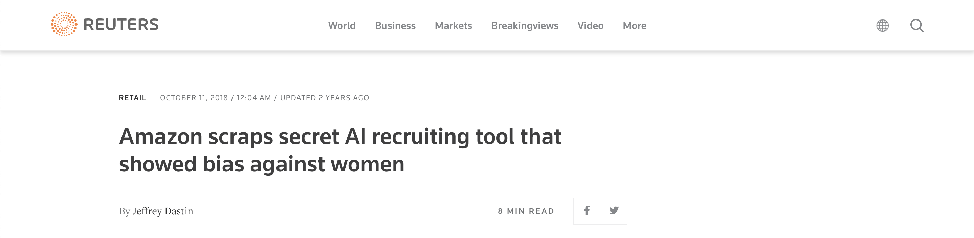
Amazon realised that the automated system they were using to shortlist candidates from their resumes was not gender neutral
The cause of this discrimination – the dataset the system was trained on
The dataset overwhelmingly contained CV’s from men
Therefore, the model taught itself that male applicants were preferable
https://www.reuters.com/article/us-amazon-com-jobs-automation-insight-idUSKCN1MK08G
Notes:
We are now going to look at two real world examples of when application of this technology has unintended negative consequences.
This example here relates to Amazon. Amazon created a recruiting tool using AI, and they realised that the automated systems they were using to shortlist candidates from their resumes were not gender neutral.
So what was the cause of this discrimination? The dataset that the system was trained on was the issue. The dataset overwhelmingly contained CVs from men. Therefore, the model taught itself that male applicants were preferable. And this here is an example of bias in a dataset. And we're going to look at the issue of bias later on in this lecture.

Slide 64
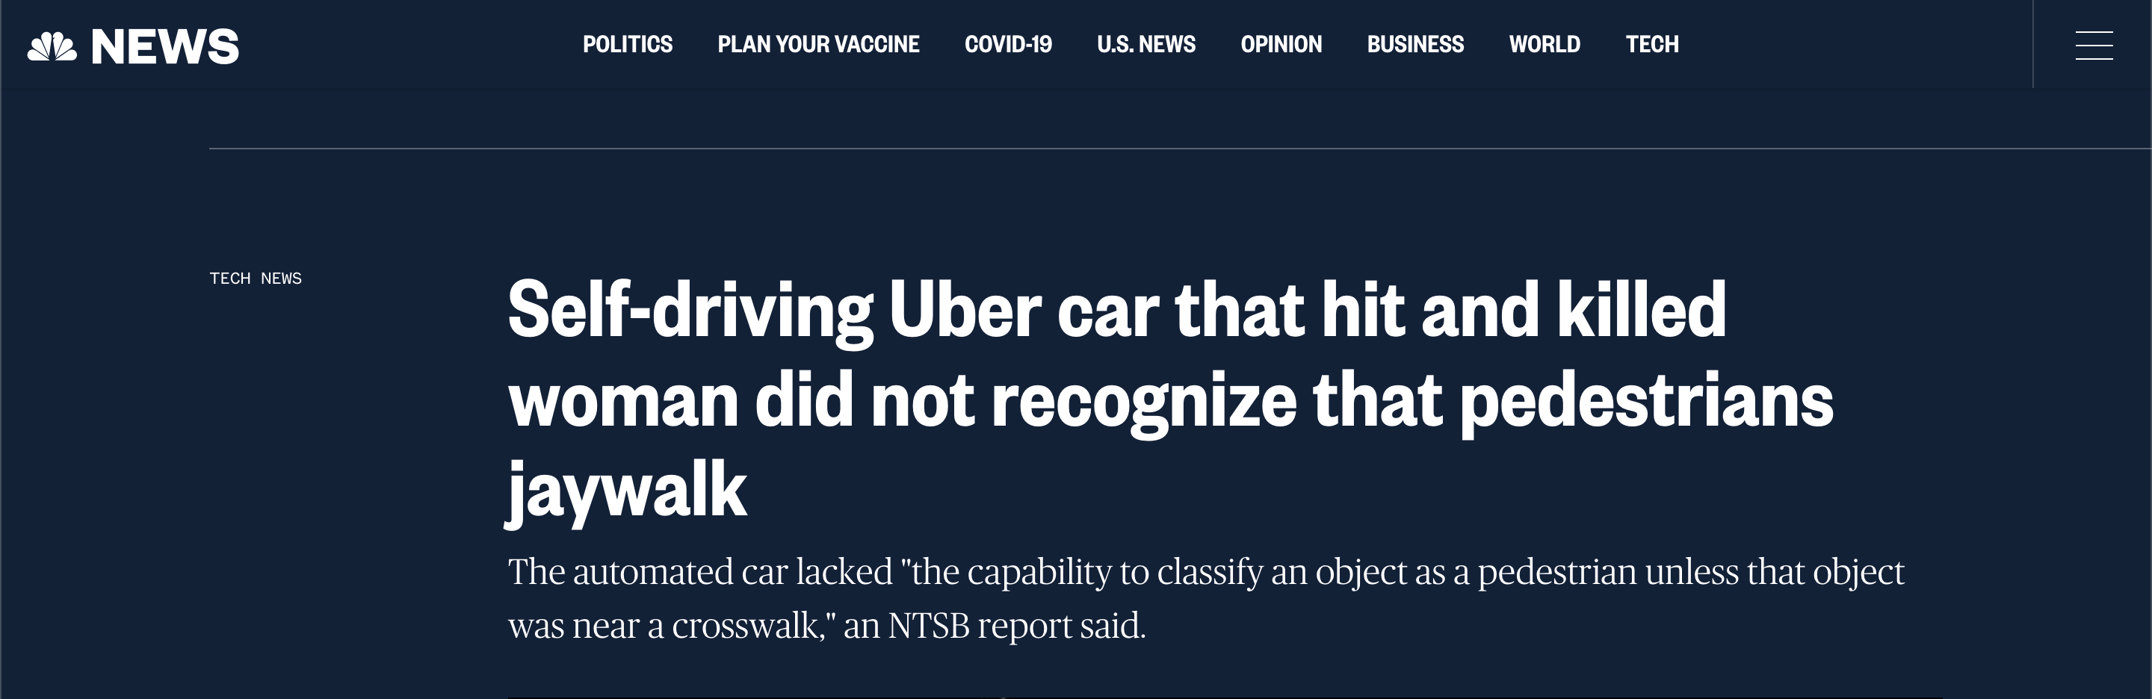
In 2018 a pedestrian was killed by an Uber self-driving car on a real-world test run
The car was engaged in autonomous mode, however there was a person in the car at the time of the accident
This raised issues of accountability and responsibility when AI systems cause harm
https://www.nbcnews.com/tech/tech-news/self-driving-uber-car-hit-killed-woman-did-not-recognize-n1079281
Notes:
Further example is a self-driving Uber car in 2018 a pedestrian was killed by an Uber self-driving car on a real world test run, the car was engaged in autonomous mode. However, there was a person in the car at the time of the accident.
And this raised a lot of issues of accountability and responsibility when AI systems cause harm.
So there was a lot of debate around this issue at the time, including who is responsible for for this accident? Is it Uber who have the responsibility in that their software didn't recognise that pedestrians often jaywalk? Or is it the person who was in the car at the time of the accident? So these are some of the ethical dilemmas that can arise through the use use of AI.

Slide 65
Data is not neutral
As a data scientist we make computations using data and present this data (often about people) as numbers.
However data originating from the real world and real people are not neutral.
The data is biased from for example social inequalities, or the type of data being collected
Therefore it is important to consider the context in which that data was produced
This allows us to note any functional limitations
E.g. Is it a fair representation of the population?
Notes:
An important concept to keep at the forefront of any decision making when using data is that it is not neutral. Often as a data scientist, we make computations using data and present this data, which is often about people as numbers. However, data originating from the real world, and real people are not neutral. The data is biased from, for example, social inequalities or the type of data being collected. Therefore, it is important to consider the context in which that data was produced. And this allows us to note any functional limitations. So, for example, one question that we can ask ourselves when looking at the dataset is, is it a fair representation of the population? And it's very important to consider this concept of not being neutral when communicating results.

Slide 66
Data is not neutral
When creating our datasets we are creating a representation.
How good is this representation of reality?
We should ask critical questions about the dataset and the choices made in creating this
Is the data representative of the population?
Are there any biases embedded in the data?
Notes:
When we are creating our data sets, we are creating a representation, and it's important to question how good this representation is of reality.
We should ask critical questions about the dataset and the choices made in creating this, is the data representative of the population? Are there any biases embedded in the dataset? So linking this back to the example of Amazon, there was bias inherent in that dataset as the majority of candidates within their dataset were male, therefore there wasn't a fair representation of the population.

Slide 67
Privacy and Data Protection
Machine learning applications often work with personal data
AI is increasingly being used for surveillance purposes
CCTV analysis
In the workplace -smartphones and social media
Often people are unaware that their data is being gathered
Data which was collected in one context is now being used by third parties in another context.
M.Coeckelbergh (2020)
Notes:
We also need to consider privacy and data protection, machine learning applications often work with personal data. AI is increasingly being used for surveillance purposes. For example, CCTV analysis in the workplace as well, the use of smartphones and social media. And often people are unaware that their data is being gathered. Alongside this, data which was collected in one context, is now being used by third parties in another context.

Slide 68
Security
We are now living in a more “networked” world
Electronic devices/software is at risk of being hacked and manipulated by people with malicious intentions
When you add AI into the mix there are much larger real-world physical consequences
E.g. if your self-driving car is hacked
M.Coeckelbergh (2020)
Notes:
Security is also an issue that we should consider. We are now living in a more networked world. This relates back to the first lecture when we talked about and the Internet of Things, IoT technologies. Electronic devices and software was at risk of being hacked and manipulated by people with malicious intentions. And when you add AI into the mix, there are much larger real world physical consequences. So for example, the example I have here is if your self-driving car is hacked, this could have very severe real world physical consequence.

Slide 69
Bias
Bias is often connected to machine learning applications
When an AI/ML model makes or recommends decisions, bias may arise
The decisions may be unjust or unfair to particular individuals or groups
While bias and discrimination have always been present in society – the worry is that AI may perpetuate these problems and enlarge their impact
Bias is often unintentional
The people involved in development don’t foresee the effects
M.Coeckelbergh (2020)
Notes:
We also have the consideration of bias and bias is often connected to machine learning applications. When AI or a machine learning model makes or recommends decisions bias may arise. The decisions may be unjust or unfair to particular individuals or groups. While bias and discrimination have always been present in society the worry is that AI may perpetuate these problems and enlarge their impact.
However, bias is often unintentional. The people involved in development don't foresee the effects, and this links back to the previous slide relating to data science by whom. Often the groups who are responsible for creating these algorithms and machine learning applications aren't representative of the users overall and often don't oversee or don't foresee the bias that's currently in that dataset.

Slide 70
Transparency and Explainability
With some AI the decision making process is clear
E.g. Decision Trees – it has been programmed in a way that determines the decision, given the input
However, with other machine learning systems – particularly deep neural networks, the decision process is no longer clear
We can explain in general how the system works, but cannot explain a particular decision
Black box problem/opaque problem
M.Coeckelbergh (2020)
Notes:
An issue within AI where there is currently a lot of research being undertaken is relating to transparency and explainability with some AI the decision making process is clear. So an example of this is the decision tree algorithm this has been programmed in a way that determines the decision, given that the input. However, with other machine learning systems, particularly deep neural networks, the decision process is no longer clear. We can explain in general how the system works, but cannot explain a particular decision. And this relates to a black box problem or opaque problem.

Slide 71
Regulations / Policy Proposals
GDPR – data is regulated
Regulations relating to AI still up for discussion
Policy – leading to regulation by means of laws
Codes of conduct, ethics and education
Notes:
So there are a number of regulations and policy proposals relating to the use of AI and machine learning. Data is quite heavily regulated. I'm sure you've all heard of GDPR and it's worthwhile getting up to scratch with these regulations and understanding these. Regulations relating to AI is still up for discussion. There is the discussion of whether it is best to go down a policy and law route so leading to regulation by means of law, or whether it's better to go through codes of conduct, ethics and education. And as part of this week, you'll be looking at a number of different code of conduct and different ethical proposals.

Slide 72
Any Questions
Dr Basel Barakat
basel.barakat@sunderland.ac.uk

